Slide 1
Logic paradigm
Prolog – a language about relationships

Slide 2
Concepts
Variables
Rules
Facts
Heuristics
Goals
Inference engine
Backward/forward chaining

Slide 3
What is Prolog
Invented early seventies by Alain Colmerauer in France and Robert Kowalski in Britain.
Prolog is a declarative programming language
In a declarative language the programmer specifies a goal to be achieved and the PROLOG system works out how to achieve it.
Relational databases owe something to PROLOG.

Slide 4
What is Prolog (continued)
Traditional programming languages (imperative) are said to be procedural.
That is the programmer must specify in detail how to solve a problem:
mix ingredients;
beat until smooth;
bake for 20 minutes in a moderate oven;
remove tin from oven;
put on bench;
close oven;
turn off oven;
In purely declarative languages, the programmer only states what the problem is and leaves the rest to the language system

Slide 5
Applications of PROLOG
Some applications of PROLOG are:
Pattern matching
AI
Expert systems

Slide 6
A PROLOG program consists of:
PROLOG really is simply a language about relationships.
It consists of 3 basic concepts - facts, rules and queries.
A collection of facts and rules is called a knowledge base. That is a knowledge base is just a set of facts and rules that describe relationships.
PROLOG programmers write knowledge bases and then query them.

Slide 7
Specifying relationships
Relations can be defined in several different ways. Some facts of the family database are:
female(X) meaning that X is a female.
male(Y) meaning that Y is a male.
parent(X, Y) meaning that X is the parent of Y
e.g.:
female(karen).
Notice that:
names of properties/relationships begin with lower case letters.
the predicate or relationship name appears as the first term
objects appear as comma-separated arguments within parentheses.
A period "." must end a fact.
objects also begin with lower case letters. They also can begin with digits (like 9020), and can be strings of characters enclosed in quotes (as in reads(fred, "War and Peace")).

Slide 8
Some examples of facts for this database are:
female(karen).
female(rosemary).
female("sun yi").
female(mahdu).
male(sam).
male(steve).
parent(sam, karen).
parent(rosemary, karen).
parent(mahdu, sam).
parent(steve, sam).
parent(rosemary, "sun yi").
What is the predicate here?
https://swish.swi-prolog.org

Slide 9
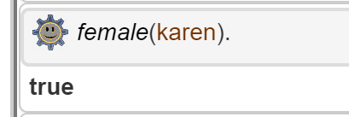
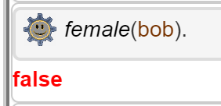
Querying Prolog
Once we have a database of facts (and, soon, rules) we can ask questions about the stored information.
Suppose we wanted to know if karen was a female?
? female(karen).
true
In SWI Prolog queries are terminated with a full stop.
To answer this query, Prolog consults its database to see if this is a known fact.
To test: ? trace(female(karen)).
What about if bob is a female?
? female(bob).
false

Slide 10
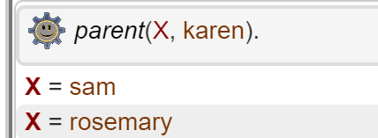
Variables
Suppose we want to ask, “Who is Karen’s parents"?
This could be written as:
Is there a parent, X, that is related to karen?
The variable X stands for an object that the questioner does not know about yet.
To answer the question, Prolog has to find out the value of X, if it exists.
As long as we do not know the value of a variable it is said to be unbound.
When a value is found, the variable is said to bound to that value.
Therefore, terms in a fact can become a variable.
The name of a variable must begin with a capital letter or an underscore character, "_".
To ask Prolog to find the parents of karen, enter this:
? parent(X,karen).

Slide 11
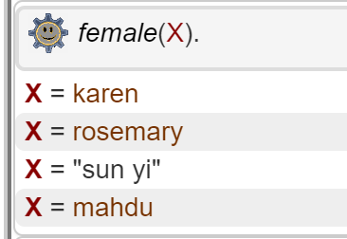
Variables (cont)
Suppose we wanted to know all the females:
? Female(X).

Slide 12
Rules
Rules are more complex relationships
":-" means "if" or "is implied by". Also called the neck symbol.
The left hand side of the neck is called the head.
The right hand side of the neck is called the body.
The comma, ",", separating the goals, stands for and.

Slide 13
Consider the following:
Facts:
animal(lion).
animal(sparrow).
has_feathers(sparrow).
Rules
bird(X) :-
animal(X),
has_feathers(X).
?- bird(B).
Prolog matches bird(B) against the head of the rule (bird(X)), and sets as new questions first animal(B) and then has_feathers(B).
Animal(B) can be satisfied by binding B to lion.
However, has_feathers(lion) isn't true, so that doesn't work.
Prolog goes back (backtracks) and tries B = sparrow. has_feathers(sparrow) is true, so that all works and prolog returns with B = sparrow as a possible solution.

Slide 14
Some rules for the family database are:
grandparent(X, Y) :- parent(X, Z), parent(Z, Y).
X is the grandparent of Y if X is the parent of Z and Z is the parent of Y
sibling(X, Y) :- parent(Z, X), parent(Z, Y), X ≠ Y.
X is the sibling of Y when Z is the parent of both X and Y, and X and Y are different people. (ie you cannot be your own sibling).

Slide 15
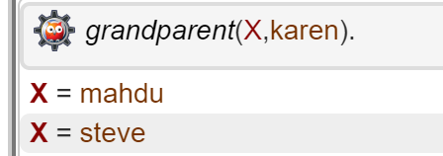
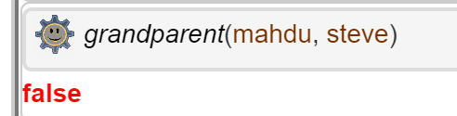
Goals – the application of queries and rules
Does Karen have grandparents and who are they?
? grandparent(X,karen).
To understand: ? trace(grandparent(X,karen)).
True or false?
? grandparent(mahdu, steve)

Slide 16
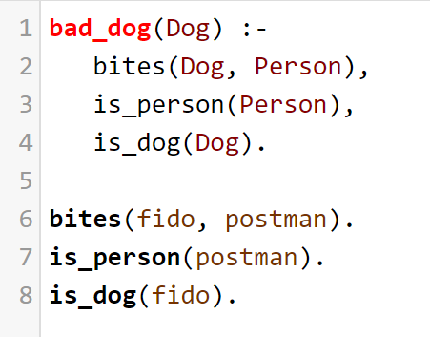
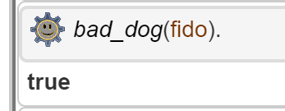
Is fido a bad dog?

